Slide 1

KENSHI
TEAM OF PROFESSIONALS

Slide 2
Team Members
Lazar Lazarov
Stefan Vyrbanov
Tihomir Arhangelov
Ivailo Petrov
Emrah Bekir
Ivailo Hristov

Slide 3
Why We Love It
Highlight all possible moves
Your pawns can be Queen
Notified when your Queen or King is in danger
Link https://github.com/emrah-it/Kenshi

Slide 4
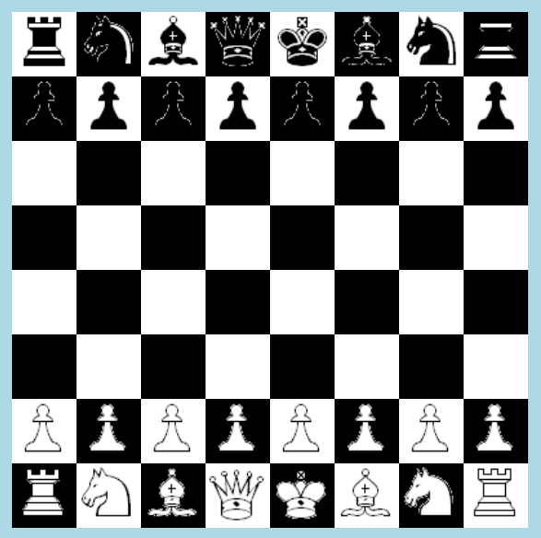
Inspired By Kassparov
Live Demo

Slide 5

Visual Studio
Live Demo

Slide 6
GitHub
Thank you for
your attention!
Follow us on: https://github.com/emrah-it/Kenshi

